Slide 1
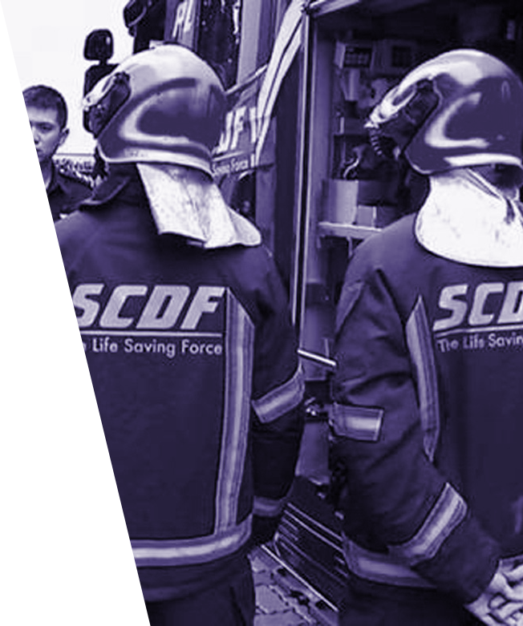
SilverDefence (SID)
Problem 1: Emergency Medical Services
Presented by Team ibmtopfan
Li Bowen, Liu Wanru, He Wanru, Zhao Fengye, Hui Wai Yan
Notes:
https://www.asiaone.com/sites/default/files/original_images/Mar2014/20140301_scdf_mediacorp.jpg

Slide 2
TABLE OF CONTENTS
01
02
INTRODUCTION
SOLUTION
03
04
DEMO
FUTURE IMPROVEMENTS
Safety issue for socially isolated seniors
Immediate assistance for seniors in need
Image classification
Gyroscope algorithm
Accuracy of data
Additional features for product

Slide 3
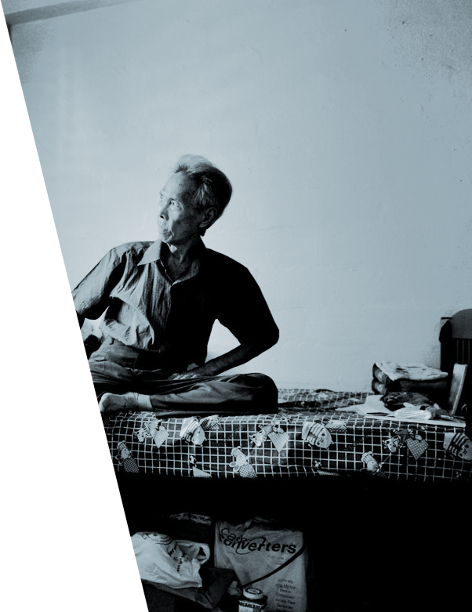
INTRODUCTION

Slide 4
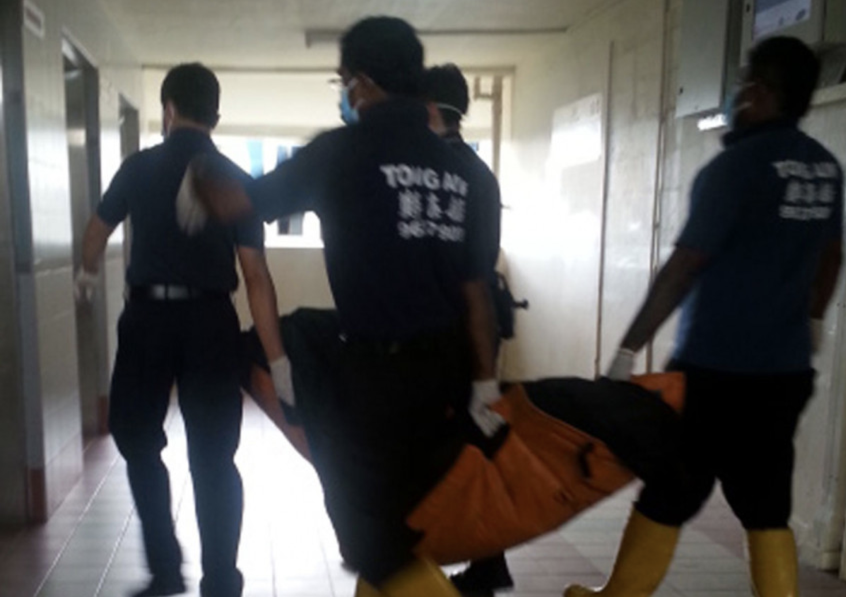
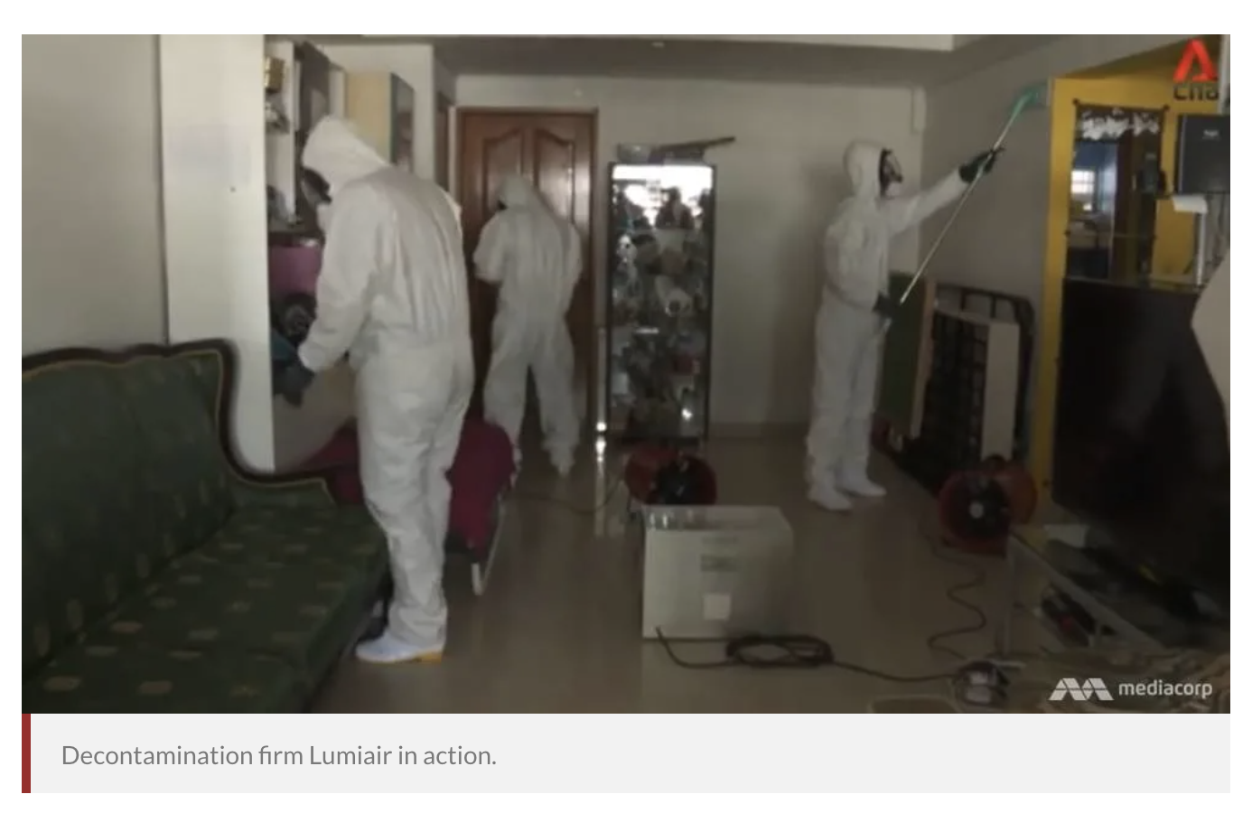
TRAGEDIES FOR ELDERLY LIVING ALONE
Transporting of the decomposed body of an elderly lady who died alone, unnoticed for days
Using an ultraviolet machine to “sterilise the entire place”, especially “close to where the body (had been)”
Notes:
https://www.asiaone.com/singapore/woman-died-alone-nobody-ever-came-visit-her-0
https://www.channelnewsasia.com/news/cnainsider/when-someone-dies-alone-singapore-this-is-what-happens-seniors-12498032

Slide 5
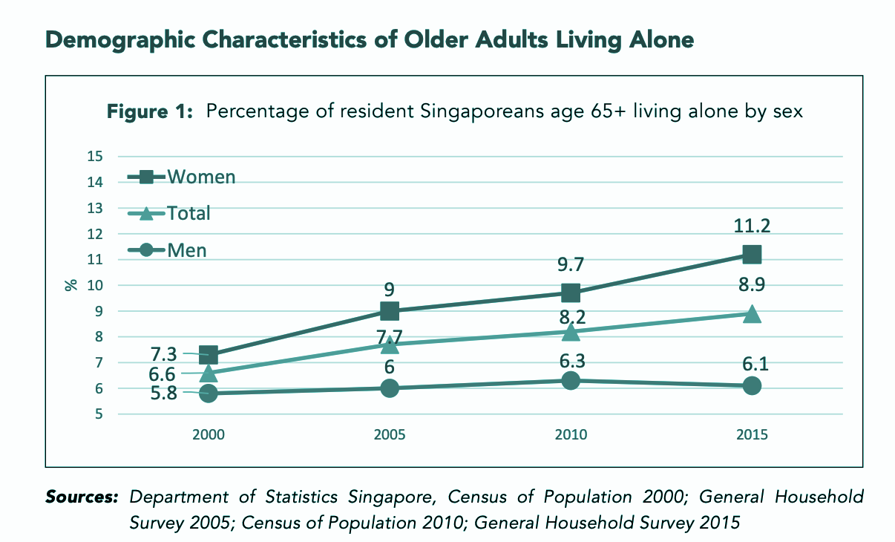
ALARMING STATISTICS
83,000
Expected Elderly Population by 2030 in Singapore
Expected increasing trend of elderly living alone by 2030
Notes:
https://www.channelnewsasia.com/news/cnainsider/the-loneliness-of-old-age-and-an-experiment-to-see-if-instagram-10675658
https://www.duke-nus.edu.sg/docs/librariesprovider3/research-policy-brief-docs/home-alone-older-adults-in-singapore.pdf?sfvrsn=6735541d_0
diag: https://www.duke-nus.edu.sg/docs/librariesprovider3/research-policy-brief-docs/home-alone-older-adults-in-singapore.pdf?sfvrsn=6735541d_0
https://epochtimes.today/singapores-elderly-loneliness-epidemic/

Slide 6
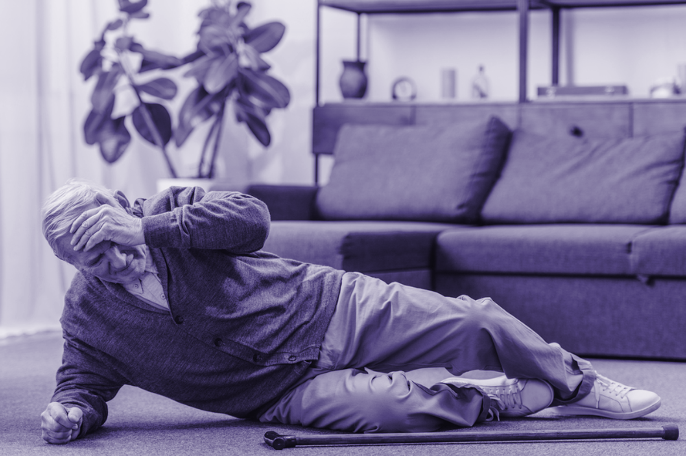
PITFALLS OF A FALL
for elderly aged 65 & above
20%
Die within a year after their fall
According to the Health Promotion Board, about 1/3 of Singaporeans aged 65 and above have recurring falls and the incidence rate increases sharply with age.
According to the World Health Organization, falls are causing as many as 646,000 deaths annually for seniors globally.
Notes:
According to the American Academy of Orthopaedic Surgeons: 20 per cent of elderly hip fracture patients die within one year after their fall;
https://orangevalley.sg/reduce-the-risk-of-falling/
pic: https://www.griswoldhomecare.com/blog/falls-elderly-statistics/

Slide 7
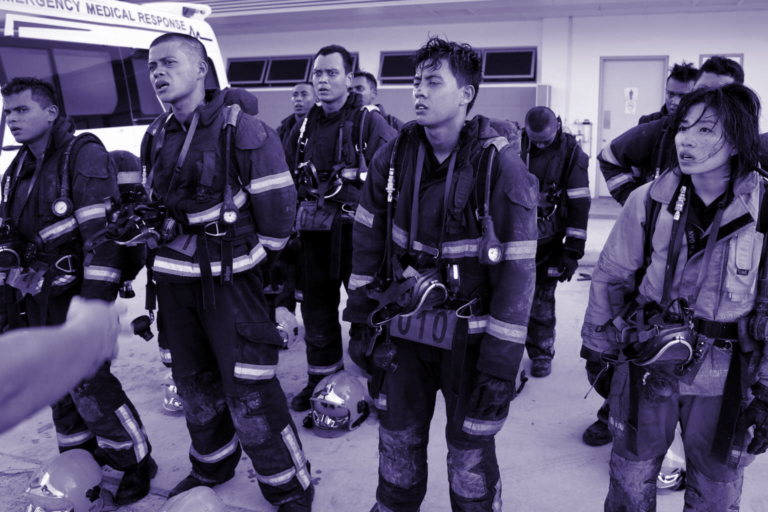
AVOIDING THE WASTE
Each case of incident requires deployment of various resources such as manpower, equipment and transport.
Over-frequent reports of minor or false cases divert resources from more serious cases, i.e. sudden attacks of acute diseases.
Accuracy in detection prevents such waste.

Slide 8
PROBLEM: TRADE-OFFS
QUICK RESPONSE
SAVING RESOURCES
To design a system to trigger emergency warnings whenever it seems like the elderly is in danger.
Ensures that no lives are lost.
To ensure that the elderly is in definite danger before the emergency response team is deployed.
Ensures that SCDF resources are not wasted due to false alarms.

Slide 9

SOLUTION
Notes:
find image for this slide

Slide 10
OUR SOLUTION
IMAGE CLASSIFICATION
ACCELERATION DETECTION
LOGIC FLOW
using IP camera
to identify a fall
of our algorithm

Slide 11

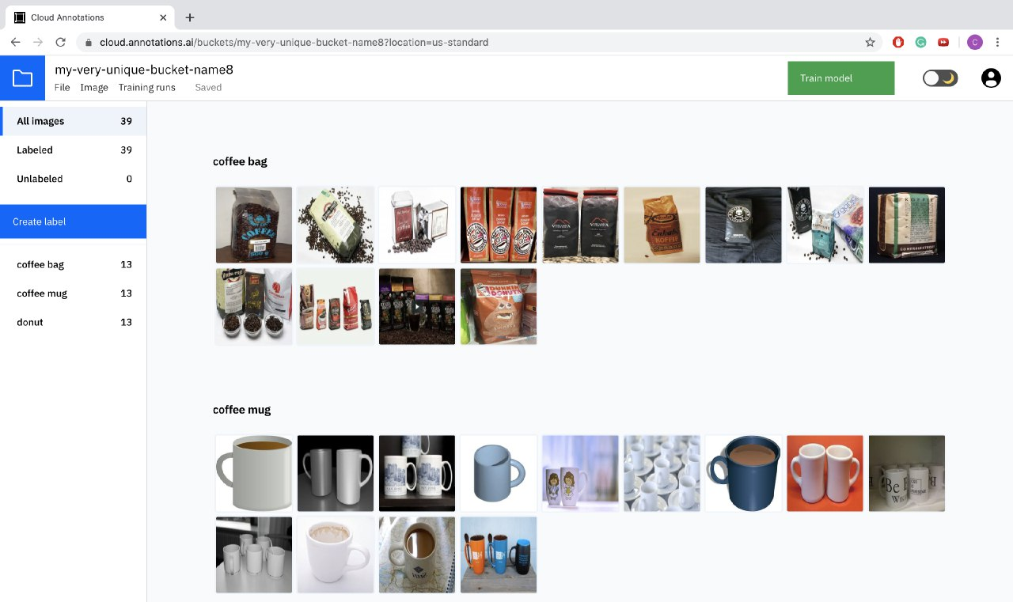
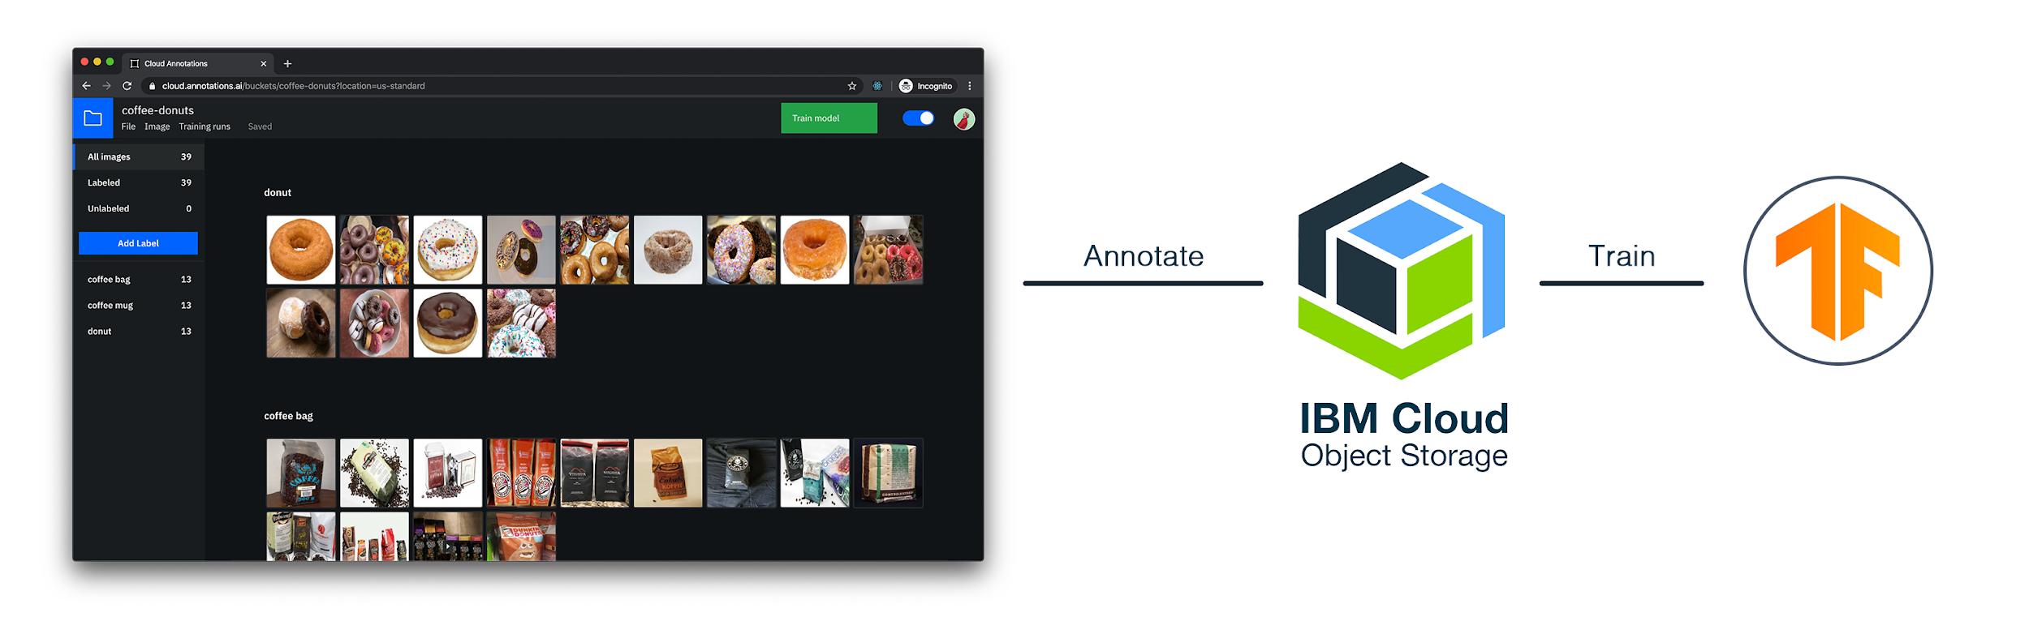
IMAGE CLASSIFICATION
IBM Watson
Visual Recognition
Equipment: IP camera setup in living room, connected via Raspberry Pi
Machine learning using IBM Cloud AI Annotations and TensorFlow
Annotate
Train
IBM CLOUD STORAGE
TENSORFLOW

Slide 12

ACCELEROMETER
Wearable on elderly to measure acceleration
To get the magnitude of acceleration, the root sum square of accelerations in x, y, z directions are obtained.
If the root sum square of the acceleration peaks at a value above the threshold, a fall might have occurred.

Slide 13
PUTTING THINGS TOGETHER: LOGIC FLOW
Accelerometer
Fall detected
No fall detected
IP Camera
IP Camera
No movement or no show for 24 hours
Lying down
Not lying down
Movement
Alert
No alert
Alert
No alert

Slide 14
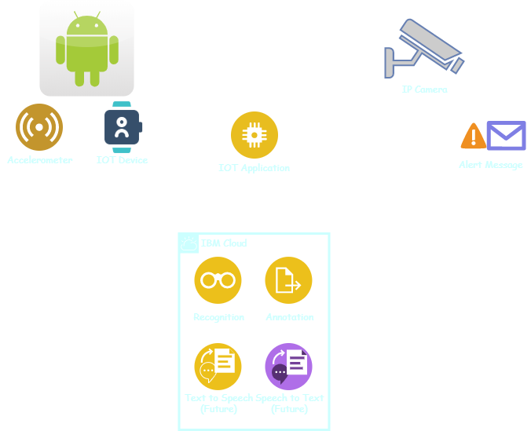
ARCHITECTURE

Slide 15
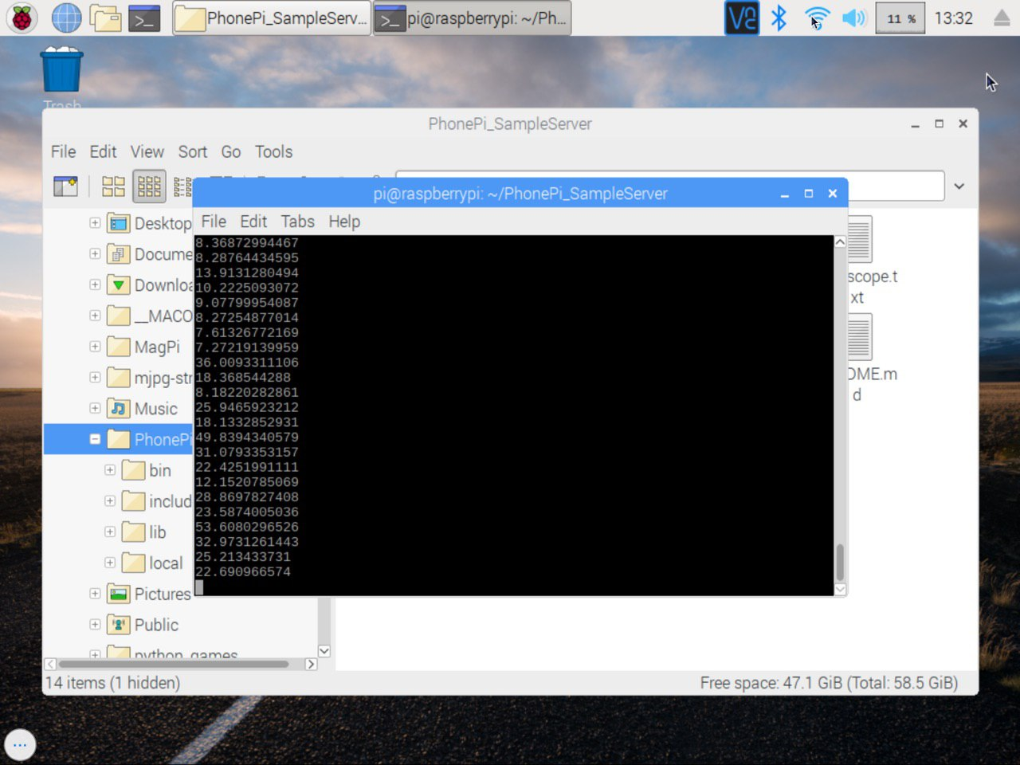

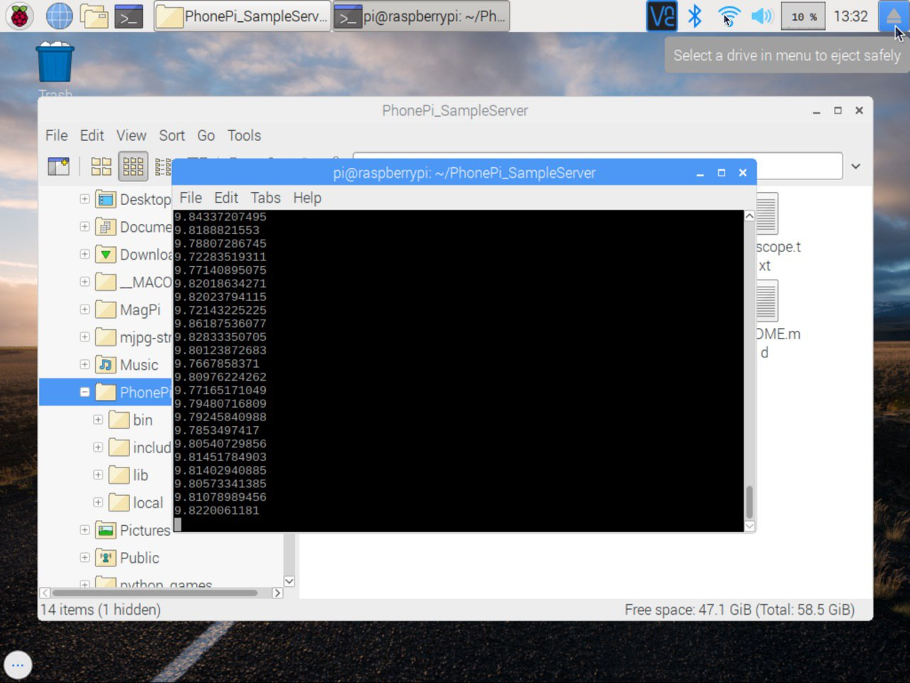
APP Demo
FALLING
NON-FALLING

Slide 16
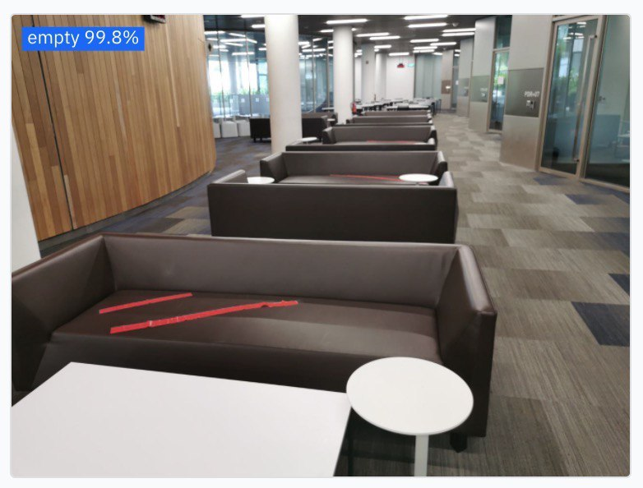
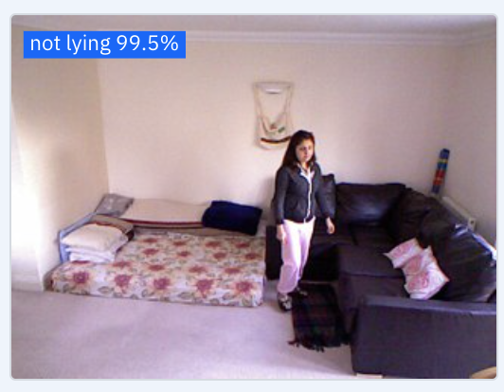
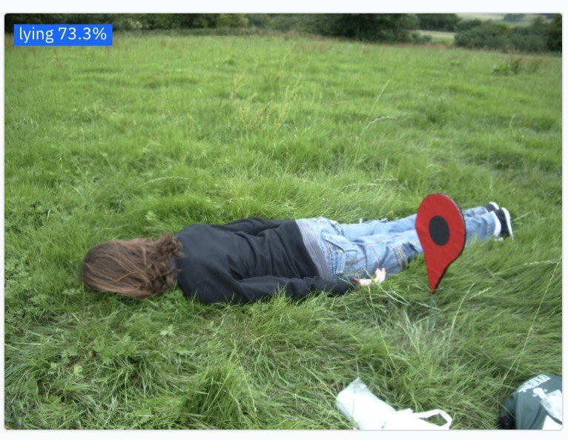
CLASSES
Empty
Not lying down
Lying down

Slide 17
FURTHER IMPROVEMENTS
Improving accuracy of predictions by finding more training data
Using a depth camera instead of the IP camera to reduce privacy concerns
Having a voice assistant to be activated when a fall is detected to confirm the need for assistance
Notes:
Limitation: gyroscope threshold for falling acceleration rather low, took data from testing env consisting of young uni students in an env where cushions are provided, hence does not simulate real situation to large extent. Better data could be collected with better controlled env.
Additional ideas:
Measuring amount of force of fall; higher fall -> more attention given; take into account weight of elderly etc

Slide 18
CONCLUSION
QUICK RESPONSE
SAVING RESOURCES
Gyroscope detection and camera image classification ensure automated detection of falls quickly.
Ensures that no lives are lost.
Double layer of detection by gyroscope and camera sieves out false alarms.
Ensures that SCDF resources are not wasted due to false alarms.

Slide 19
THANK YOU

